Slide 1
Reporting Aggregated Data
Using the Group Functions

Slide 2
Objectives
After completing this lesson, you should be able to do the following:
  Identify the available group functions
  Describe the use of group functions
  Group data by using the GROUP BY clause
  Include or exclude grouped rows by using the HAVING clause
Notes:
Oracle Database 10g: SQL Fundamentals I 4 - <number>
Objectives
This lesson further addresses functions. It focuses on obtaining summary information (such as averages) for groups of rows. It discusses how to group rows in a table into smaller sets and how to specify search criteria for groups of rows.

Slide 3
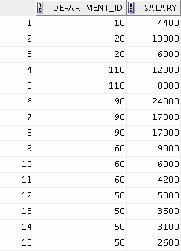

What Are Group Functions?
Group functions operate on sets of rows to give one result per group.
EMPLOYEES
Maximum salary in EMPLOYEES table
…
Notes:
Oracle Database 10g: SQL Fundamentals I 4 - <number>
Group Functions
Unlike single-row functions, group functions operate on sets of rows to give one result per group. These sets may comprise the entire table or the table split into groups.

Slide 4
Types of Group Functions
  AVG
  COUNT
  MAX
  MIN
  STDDEV
  SUM
  VARIANCE
Group
functions
Notes:
Oracle Database 10g: SQL Fundamentals I 4 - <number>
Types of Group Functions
Each of the functions accepts an argument. The following table identifies the options that you can use in the syntax:

Slide 5
Group Functions: Syntax
SELECT [column,] group_function(column), ...
FROM table
[WHERE condition]
[GROUP BY column]
[ORDER BY column];
Notes:
Oracle Database 10g: SQL Fundamentals I 4 - <number>
Guidelines for Using Group Functions
DISTINCT makes the function consider only nonduplicate values; ALL makes it consider every value, including duplicates. The default is ALL and therefore does not need to be specified.
The data types for the functions with an expr argument may be CHAR, VARCHAR2, NUMBER, or DATE.
All group functions ignore null values. To substitute a value for null values, use the NVL, NVL2, or COALESCE functions.

Slide 6
Using the AVG and SUM Functions
You can use AVG and SUM for numeric data.
SELECT AVG(salary), MAX(salary),
MIN(salary), SUM(salary)
FROM employees
WHERE job_id LIKE '%REP%';
Notes:
Oracle Database 10g: SQL Fundamentals I 4 - <number>
Using the Group Functions
You can use AVG, SUM, MIN, and MAX functions against columns that can store numeric data. The example in the slide displays the average, highest, lowest, and sum of monthly salaries for all sales representatives.

Slide 7

Using the MIN and MAX Functions
You can use MIN and MAX for numeric, character, and date data types.
SELECT MIN(hire_date), MAX(hire_date)
FROM employees;
Notes:
Oracle Database 10g: SQL Fundamentals I 4 - <number>
Using the Group Functions (continued)
You can use the MAX and MIN functions for numeric, character, and date data types. The slide example displays the most junior and most senior employees.
The following example displays the employee last name that is first and the employee last name that is last in an alphabetized list of all employees:
SELECT MIN(last_name), MAX(last_name)
FROM employees;
Note: The AVG, SUM, VARIANCE, and STDDEV functions can be used only with numeric data types. MAX and MIN cannot be used with LOB or LONG data types.

Slide 8


Using the COUNT Function
COUNT(*) returns the number of rows in a table:
COUNT(expr) returns the number of rows with non-null values for expr:
SELECT COUNT(*)
FROM employees
WHERE department_id = 50;
1
SELECT COUNT(commission_pct)
FROM employees
WHERE department_id = 80;
2
Notes:
Oracle Database 10g: SQL Fundamentals I 4 - <number>
COUNT Function
The COUNT function has three formats:
COUNT(*)
COUNT(expr)
COUNT(DISTINCT expr)
COUNT(*) returns the number of rows in a table that satisfy the criteria of the SELECT statement, including duplicate rows and rows containing null values in any of the columns. If a WHERE clause is included in the SELECT statement, COUNT(*) returns the number of rows that satisfy the condition in the WHERE clause.
In contrast, COUNT(expr) returns the number of non-null values that are in the column identified by expr.
COUNT(DISTINCT expr) returns the number of unique, non-null values that are in the column identified by expr.
Examples
1. The slide example displays the number of employees in department 50.
2. The slide example displays the number of employees in department 80 who can earn a commission.

Slide 9

Using the DISTINCT Keyword
  COUNT(DISTINCT expr) returns the number of distinct non-null values of expr.
  To display the number of distinct department values in the EMPLOYEES table:
SELECT COUNT(DISTINCT department_id)
FROM employees;
Notes:
Oracle Database 10g: SQL Fundamentals I 4 - <number>
DISTINCT Keyword
Use the DISTINCT keyword to suppress the counting of any duplicate values in a column.
The example in the slide displays the number of distinct department values that are in the EMPLOYEES table.

Slide 10


Group Functions and Null Values
Group functions ignore null values in the column:
The NVL function forces group functions to include null values:
1
SELECT AVG(commission_pct)
FROM employees;
SELECT AVG(NVL(commission_pct, 0))
FROM employees;
2
Notes:
Oracle Database 10g: SQL Fundamentals I 4 - <number>
Group Functions and Null Values
All group functions ignore null values in the column.
The NVL function forces group functions to include null values.
Examples
The average is calculated based on only those rows in the table where a valid value is stored in the COMMISSION_PCT column. The average is calculated as the total commission that is paid to all employees divided by the number of employees receiving a commission (four).
The average is calculated based on all rows in the table, regardless of whether null values are stored in the COMMISSION_PCT column. The average is calculated as the total commission that is paid to all employees divided by the total number of employees in the company (20).

Slide 11
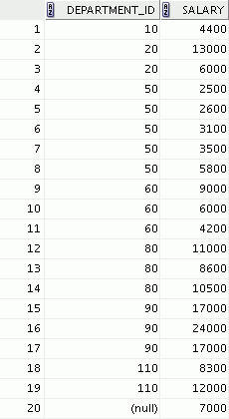
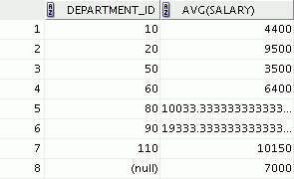
Creating Groups of Data
EMPLOYEES
4400
9500
3500
Average
salary in the
EMPLOYEES
table for each
department
6400
10033
19333
10150
7000
Notes:
Oracle Database 10g: SQL Fundamentals I 4 - <number>
Creating Groups of Data
Until this point in our discussion, all group functions have treated the table as one large group of information.
At times, however, you need to divide the table of information into smaller groups. You can do this by using the GROUP BY clause.

Slide 12
Creating Groups of Data:
GROUP BY Clause Syntax
You can divide rows in a table into smaller groups by using the GROUP BY clause.
SELECT column, group_function(column)
FROM table
[WHERE condition]
[GROUP BY group_by_expression]
[ORDER BY column];
Notes:
Oracle Database 10g: SQL Fundamentals I 4 - <number>
GROUP BY Clause
You can use the GROUP BY clause to divide the rows in a table into groups. You can then use the group functions to return summary information for each group.
In the syntax:
group_by_expression specifies columns whose values determine the basis for
grouping rows
Guidelines
If you include a group function in a SELECT clause, you cannot select individual results as well, unless the individual column appears in the GROUP BY clause. You receive an error message if you fail to include the column list in the GROUP BY clause.
Using a WHERE clause, you can exclude rows before dividing them into groups.
You must include the columns in the GROUP BY clause.
You cannot use a column alias in the GROUP BY clause.

Slide 13
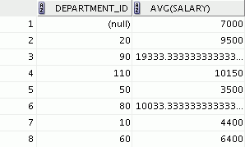
Using the GROUP BY Clause
All columns in the SELECT list that are not in group functions must be in the GROUP BY clause.
SELECT department_id, AVG(salary)
FROM employees
GROUP BY department_id ;
Notes:
Oracle Database 10g: SQL Fundamentals I 4 - <number>
Using the GROUP BY Clause
When using the GROUP BY clause, make sure that all columns in the SELECT list that are not group functions are included in the GROUP BY clause. The example in the slide displays the department number and the average salary for each department. Here is how this SELECT statement, containing a GROUP BY clause, is evaluated:
The SELECT clause specifies the columns to be retrieved, as follows:
Department number column in the EMPLOYEES table
The average of all the salaries in the group that you specified in the GROUP BY clause
The FROM clause specifies the tables that the database must access: the EMPLOYEES table.
The WHERE clause specifies the rows to be retrieved. Because there is no WHERE clause, all rows are retrieved by default.
The GROUP BY clause specifies how the rows should be grouped. The rows are grouped by department number, so the AVG function that is applied to the salary column calculates the average salary for each department.

